Slide 1


Mergers and Acquisitions Toolkit
Overview

Slide 2
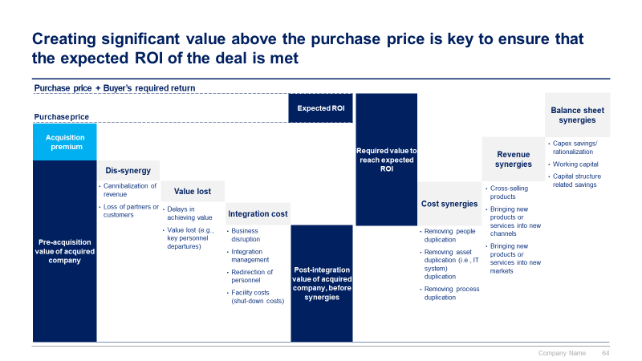
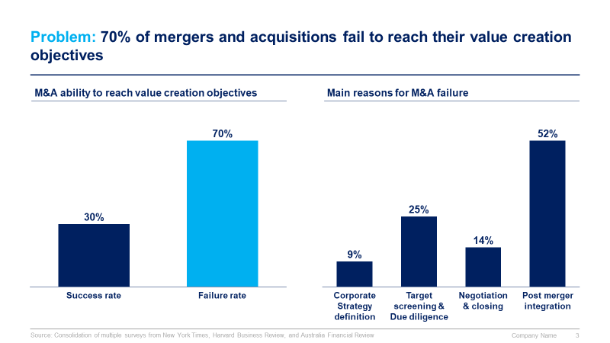
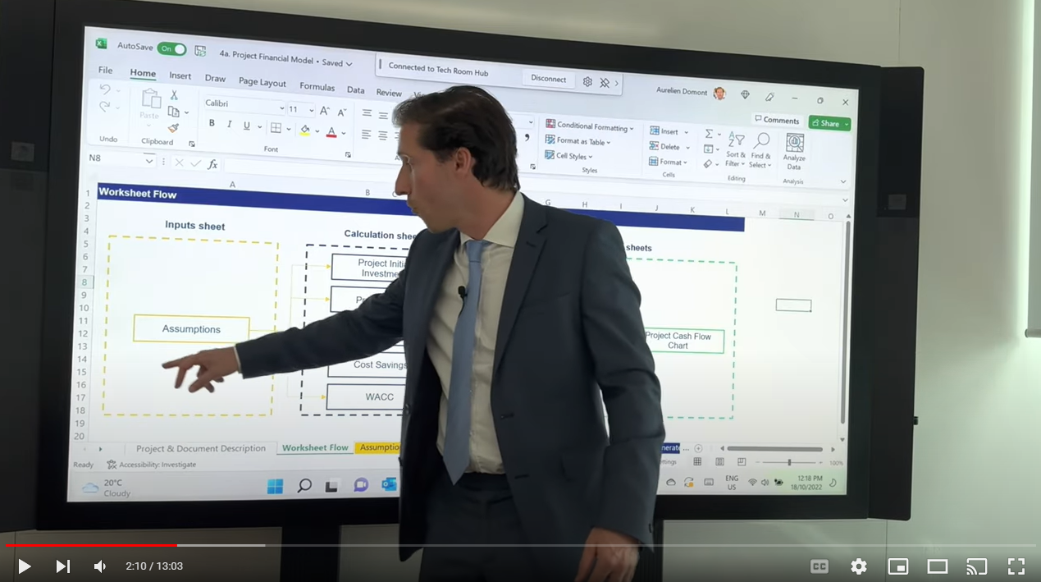
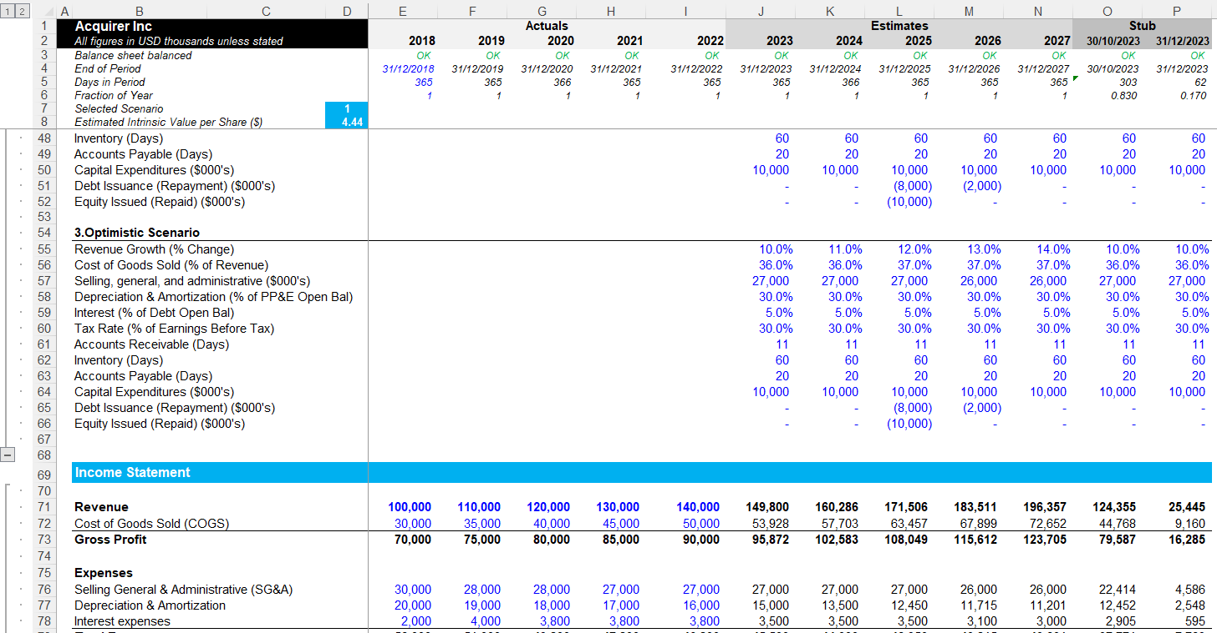
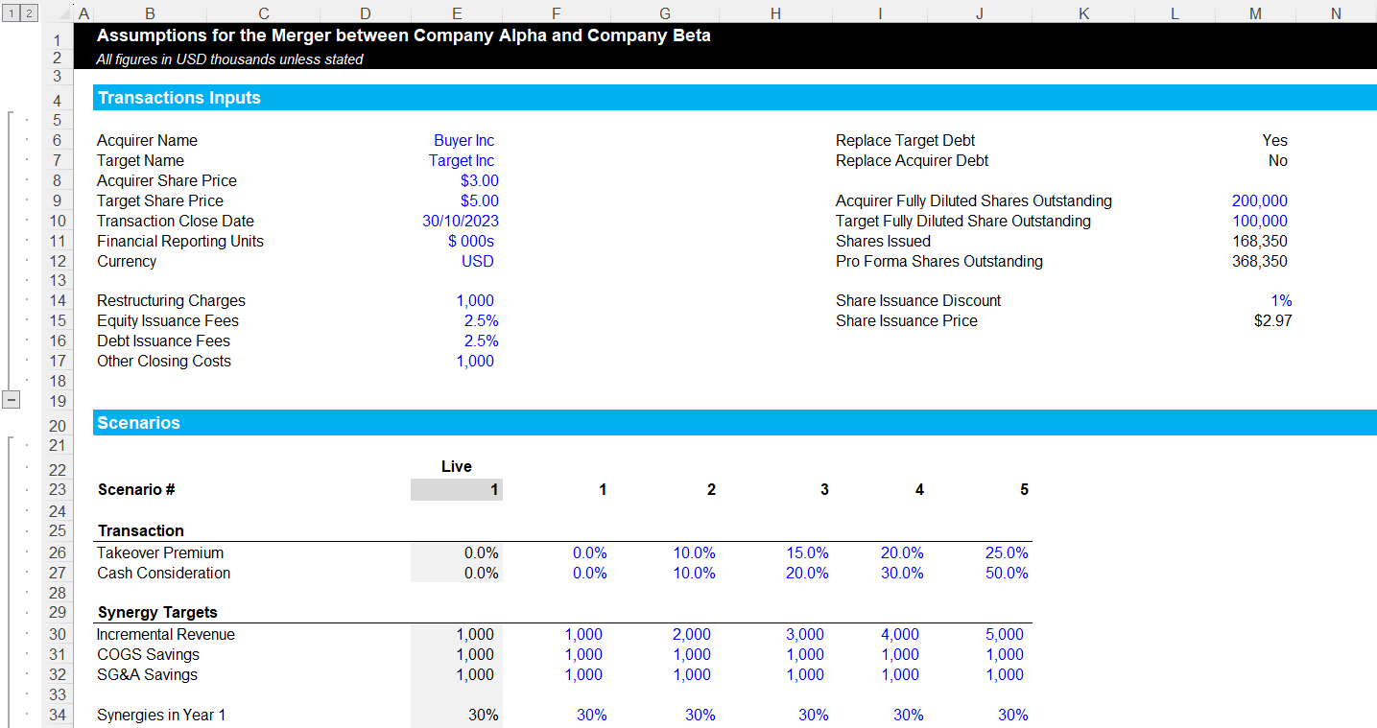
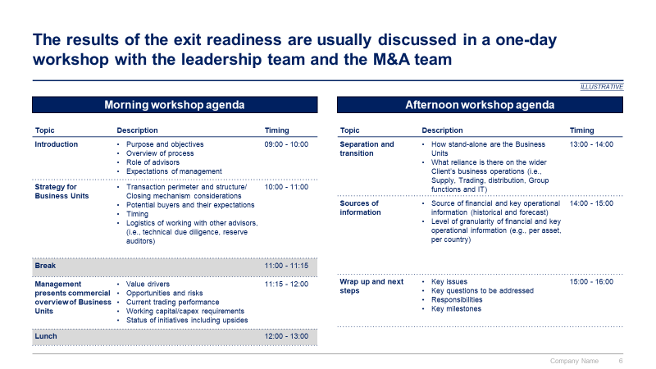
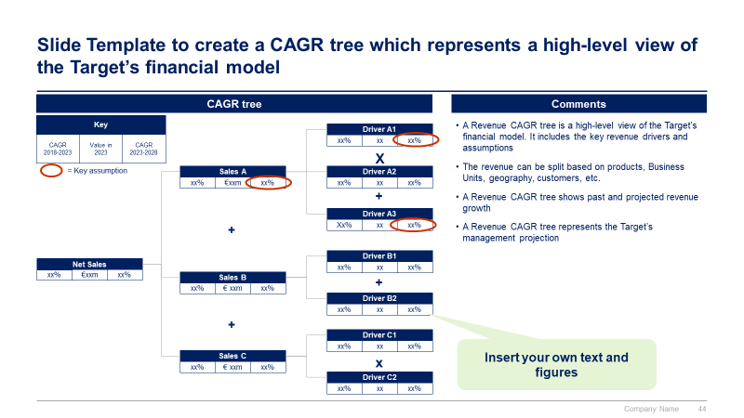
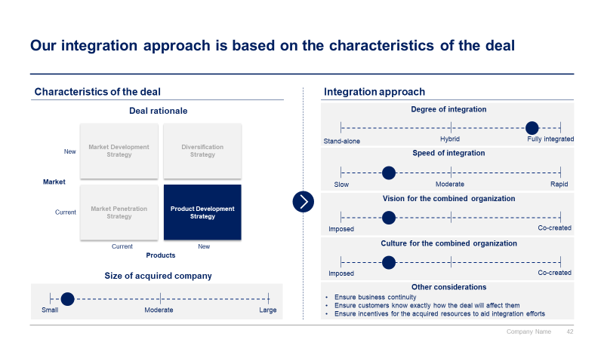
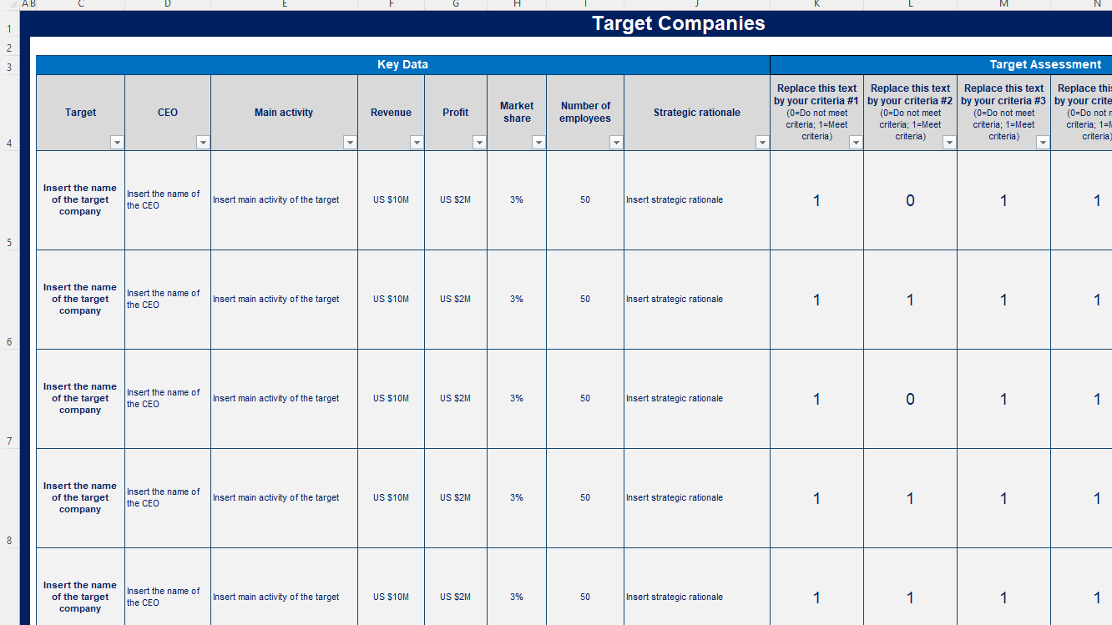

Slide 3


Introduction
This M&A Toolkit was created by former JP Morgan Investment Bankers, and McKinsey & Deloitte Consultants, after more than 4,000 hours of work. It is considered the world's best & most comprehensive Mergers and Acquisitions Toolkit. It includes all the Frameworks, Best Practices & Templates required to improve the M&A capability of your organization and boost your personal career.
Join the 200,000+ Executives, Consultants & Entrepreneurs who are already leveraging our Management Consulting Toolkits to improve the performance of their organization and boost their own career.
If you have any questions, send us an email at support@domontconsulting.com and one of our ex-McKinsey, Deloitte & BCG Management Consultants will get back to you within 2 business days.
Aurelien Domont
Management Consultant
Domont Consulting Managing Director

Slide 4
Problem: 70% of mergers and acquisitions fail to reach their value creation objectives
M&A ability to reach value creation objectives
Main reasons for M&A failure
Success rate
Failure rate
Corporate Strategy definition
Target screening & Due diligence
Negotiation & closing
Post merger integration
Source: Consolidation of multiple surveys from New York Times, Harvard Business Review, and Australia Financial Review

Slide 5












Solution: Our ex-JP Morgan Investment Bankers, and McKinsey & Deloitte Consultants created an M&A Toolkit to increase your odds of success
What’s inside the Toolkit?
Who created the Toolkit?
The Toolkit was created by former JP Morgan Investment Bankers, and McKinsey & Deloitte Consultants.
Best Practices
Frameworks
Number of professionals leveraging our Toolkits
Advice from
tier-1 Management Consultants
Tools
There are 200,000+ Executives, Consultants & Entrepreneurs leveraging our Toolkits to improve the performance of their organization
Real-life Examples
Templates
Trusted by small and large organizations
Video Training
Step-by-step Tutorials

Slide 6
Our Toolkit will help you fulfill multiple objectives
The M&A Toolkit includes frameworks, tools, templates, tutorials, real-life examples, video training, and best practices to help you:
Improve the M&A capability of your organization and boost your personal career with our 7-phase approach: (I) Define your M&A Strategy, (II) Identify Target Companies, (III) Build a Business Case and Financial Model, (IV) Conduct a Due Diligence, (V) Execute Transaction, (VI) Conduct the Post Merger Integration, (VII) Activities specific to Carve-outs
(I) Define your M&A Strategy: (1) Company mission, vision and values, (2) M&A key considerations, (3) M&A strategic objectives and key performance indicators, (4) M&A team, (5) M&A guiding principles, (6) Target screening criteria, (7) Current M&A pipeline
(II) Identify Target Companies: (1) Potential target companies and data collection, (2) High-level assessment of potential target companies, (3) Shortlisted potential targets, (4) Financial statements analysis, (5) Valuation: DCF model, comparable company analysis, and precedent transaction analysis, (6) Targets approved for the business case phase
(III) Build a Business Case and Financial Model: (1) Strategic benefit, (2) Feasibility, (3) Financial benefit, (4) Comprehensive M&A financial model including acquirer model, target model, merger assumptions & analysis, and pro forma model, (5) Simple Financial model including integration cost, revenue synergy, cost synergy, NPV, ROI, and IRR, (6) Letter of intent or term sheet
(IV) Conduct a Due Diligence: (1) Data room and clean room, (2) Work plan including key business case hypotheses & assumptions, (3) Due diligence to validate key hypotheses and assumptions, (4) Updated valuation, business case, and financial model, (5) Recommendation to make (or not) a formal offer to acquire the target company
(V) Execute Transaction: (1) Deal structure, (2) Sale and purchase agreement (SPA), (3) M&A negotiations, (4) Signing and closing the M&A deal
(VI) Conduct the Post Merger Integration: (1) Integration strategy, (2) Integration & synergy initiatives, (3) Detailed Plans, (4) Implementation & Monitoring, (5) Change Management and Internal Communication, (6) Stakeholder Engagement
(VII) Activities specific to Carve-outs: (1) Exit readiness, (2) Transaction perimeter , (3) Separation concepts, (4) Management presentation, (5) Legal entity, (6) Separation execution

Slide 7

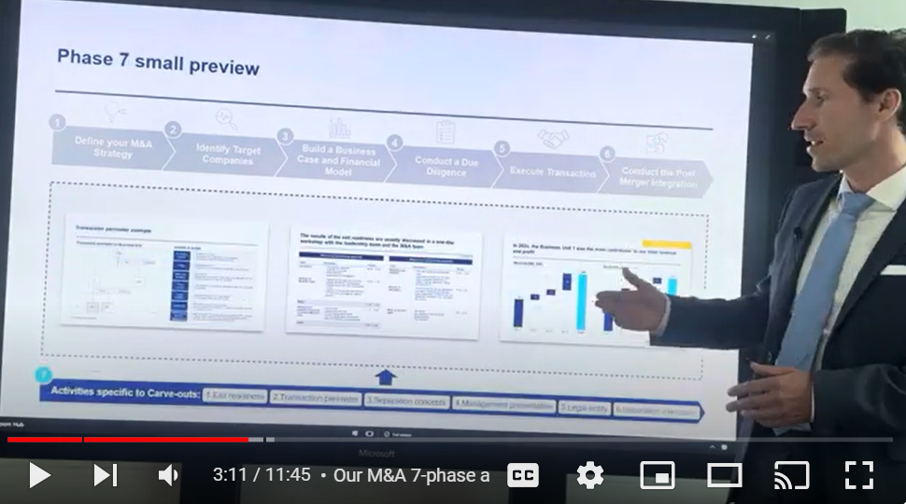
Video demonstration of the Toolkit
Video Demo Access
Video Demo Visual
Select “Slide Show” mode and then click on the link below or on the image on the right to access this video demo.
You can also access the video by copy pasting the following URL in your browser:
https://youtu.be/ewTytjEdvS8

Slide 8






The Toolkit includes a 7-phase approach that we have built and refined over the past 20 years through constant trial and error
1
2
3
4
5
6
Define your M&A Strategy
Identify Target Companies
Build a Business Case and Financial Model
Conduct a Due Diligence
Execute Transaction
Conduct the Post Merger Integration
Company mission, vision and values
M&A key considerations
M&A strategic objectives and key performance indicators
M&A team
M&A guiding principles
Target screening criteria
Current M&A pipeline
Potential target companies and data collection
High-level assessment of potential target companies
Shortlisted potential targets
Financial statements analysis
Valuation: DCF model, comparable company analysis, and precedent transaction analysis
Targets approved for the business case phase
Strategic benefit
Feasibility
Financial benefit
Comprehensive M&A financial model including acquirer model, target model, merger assumptions & analysis, and pro forma model
Simple Financial model including integration cost, revenue synergy, cost synergy, NPV, ROI, and IRR
Letter of intent or term sheet
Data room and clean room
Work plan including key business case hypotheses & assumptions
Due diligence to validate key hypotheses and assumptions
Updated valuation, business case, and financial model
Recommendation to make (or not) a formal offer to acquire the target company
Deal structure
Sale and purchase agreement (SPA)
M&A negotiations
Signing and closing the M&A deal
Integration strategy
Integration & synergy initiatives
Detailed Plans
Implementation & Monitoring
Change Management and Internal Communication
Stakeholder Engagement
7
Activities specific to Carve-outs:
1.Exit readiness
2.Transaction perimeter
3.Separation concepts
4.Management presentation
5.Legal entity
6.Separation execution

Slide 9





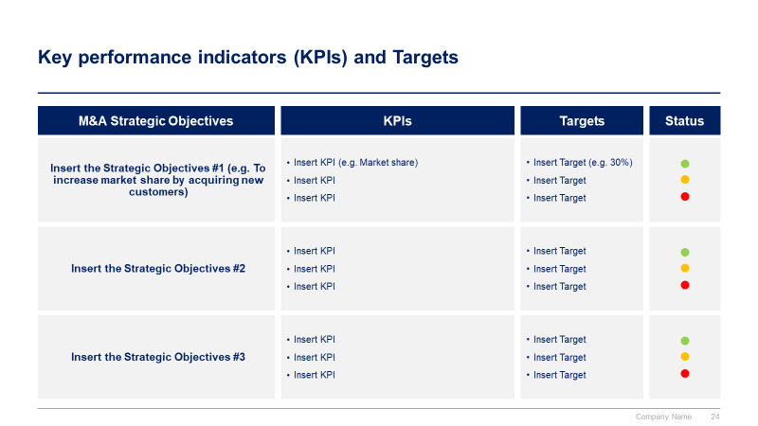
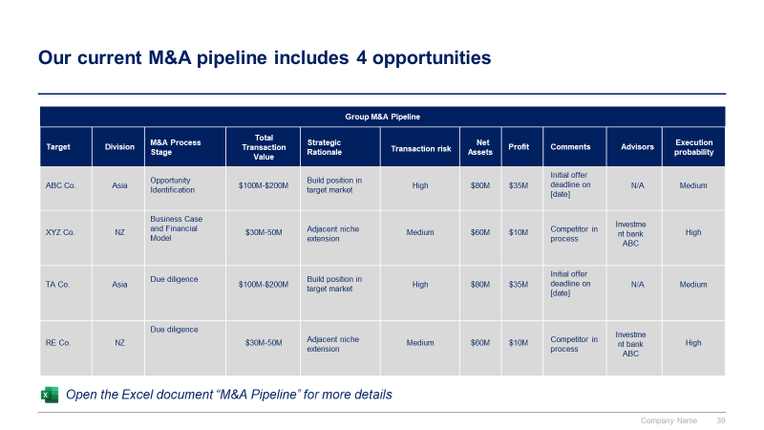
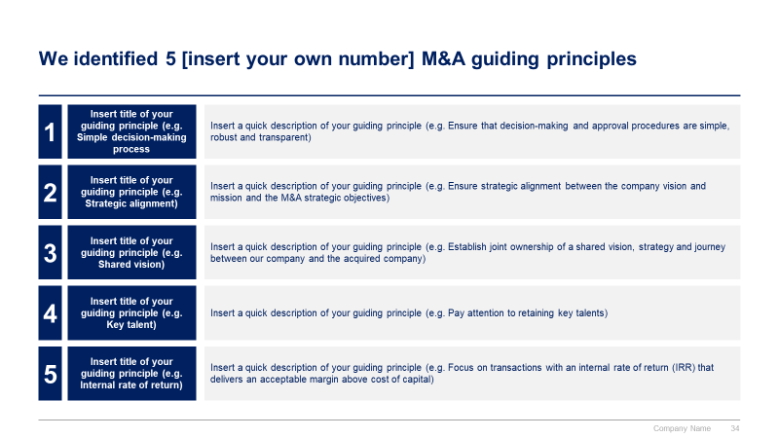
Phase 1 small preview
1
2
3
4
5
6
Define your M&A Strategy
Identify Target Companies
Build a Business Case and Financial Model
Conduct a Due Diligence
Execute Transaction
Conduct the Post Merger Integration
7
Activities specific to Carve-outs:
1.Exit readiness
2.Transaction perimeter
3.Separation concepts
4.Management presentation
5.Legal entity
6.Separation execution

Slide 10

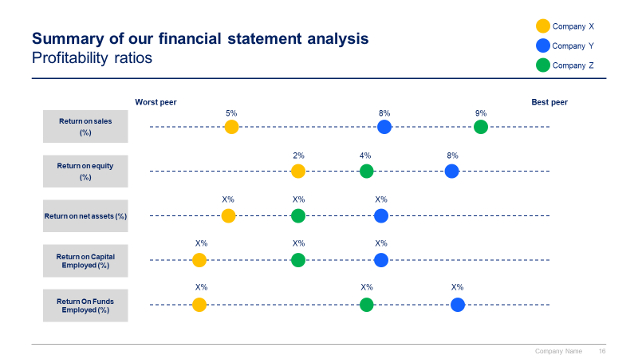
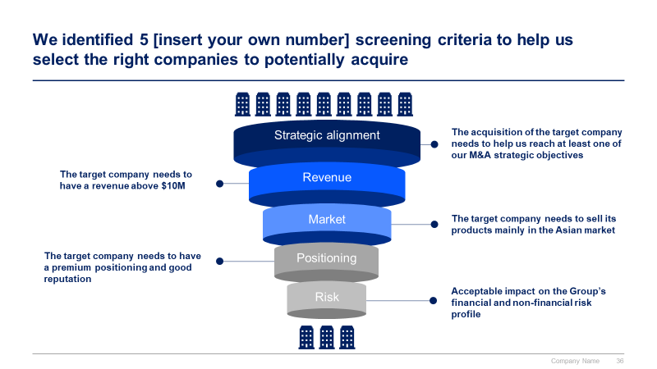
Phase 2 small preview
1
2
3
4
5
6
Define your M&A Strategy
Identify Target Companies
Build a Business Case and Financial Model
Conduct a Due Diligence
Execute Transaction
Conduct the Post Merger Integration
7
Activities specific to Carve-outs:
1.Exit readiness
2.Transaction perimeter
3.Separation concepts
4.Management presentation
5.Legal entity
6.Separation execution

Slide 11
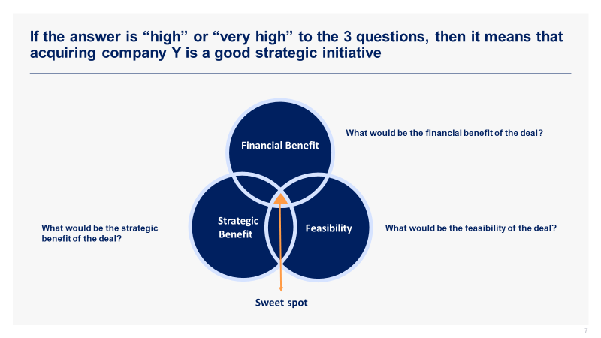
Phase 3 small preview
1
2
3
4
5
6
Define your M&A Strategy
Identify Target Companies
Build a Business Case and Financial Model
Conduct a Due Diligence
Execute Transaction
Conduct the Post Merger Integration
7
Activities specific to Carve-outs:
1.Exit readiness
2.Transaction perimeter
3.Separation concepts
4.Management presentation
5.Legal entity
6.Separation execution

Slide 12
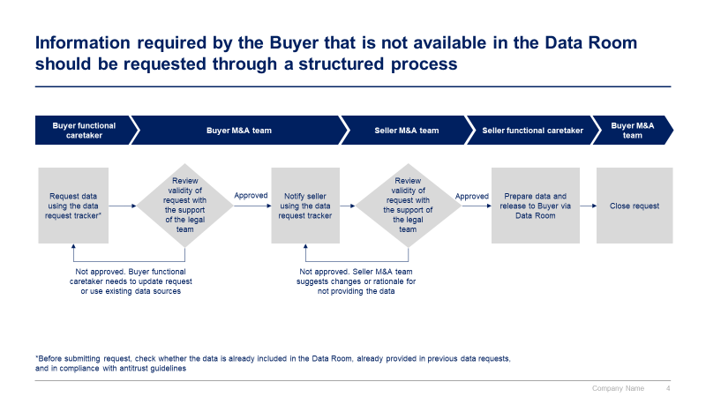
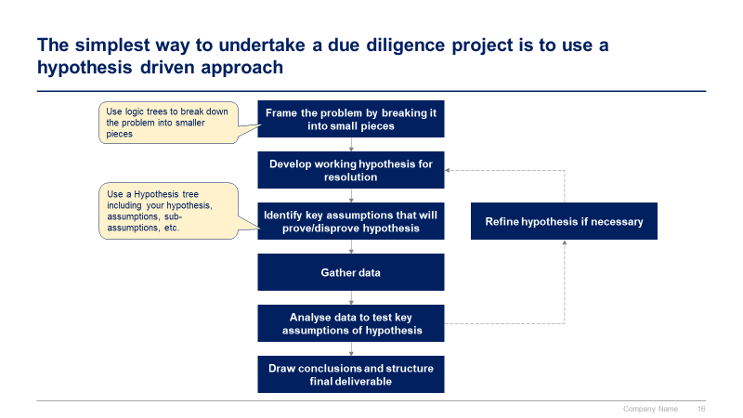
Phase 4 small preview
1
2
3
4
5
6
Define your M&A Strategy
Identify Target Companies
Build a Business Case and Financial Model
Conduct a Due Diligence
Execute Transaction
Conduct the Post Merger Integration
7
Activities specific to Carve-outs:
1.Exit readiness
2.Transaction perimeter
3.Separation concepts
4.Management presentation
5.Legal entity
6.Separation execution

Slide 13
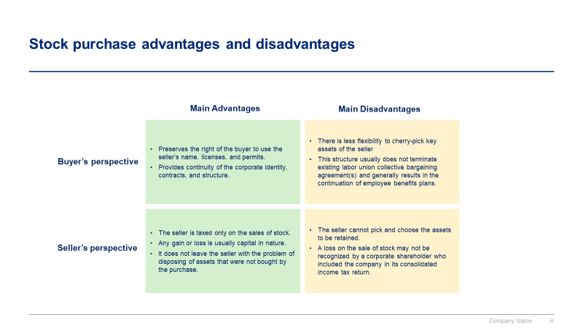
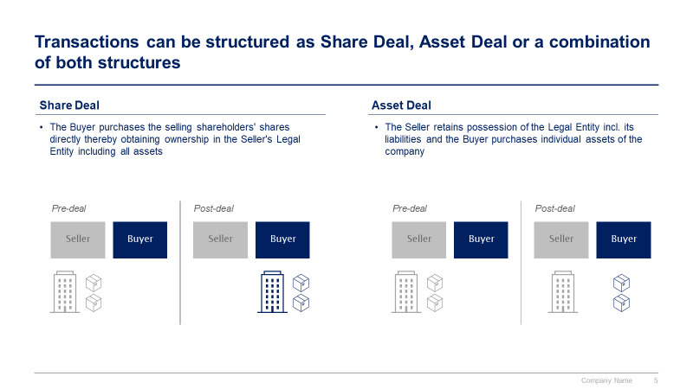
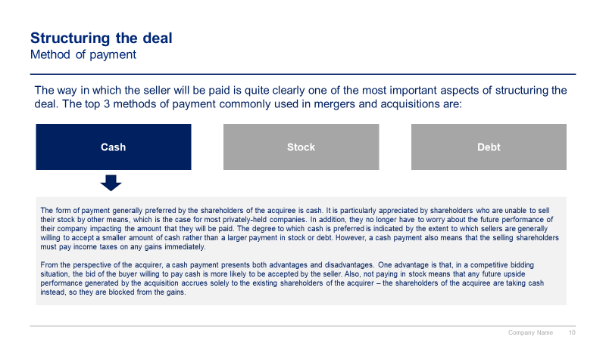
Phase 5 small preview
1
2
3
4
5
6
Define your M&A Strategy
Identify Target Companies
Build a Business Case and Financial Model
Conduct a Due Diligence
Execute Transaction
Conduct the Post Merger Integration
7
Activities specific to Carve-outs:
1.Exit readiness
2.Transaction perimeter
3.Separation concepts
4.Management presentation
5.Legal entity
6.Separation execution

Slide 14
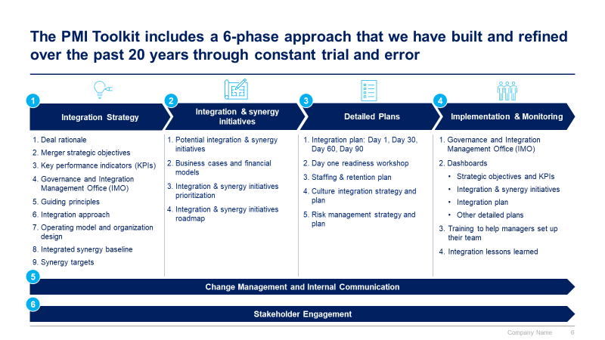
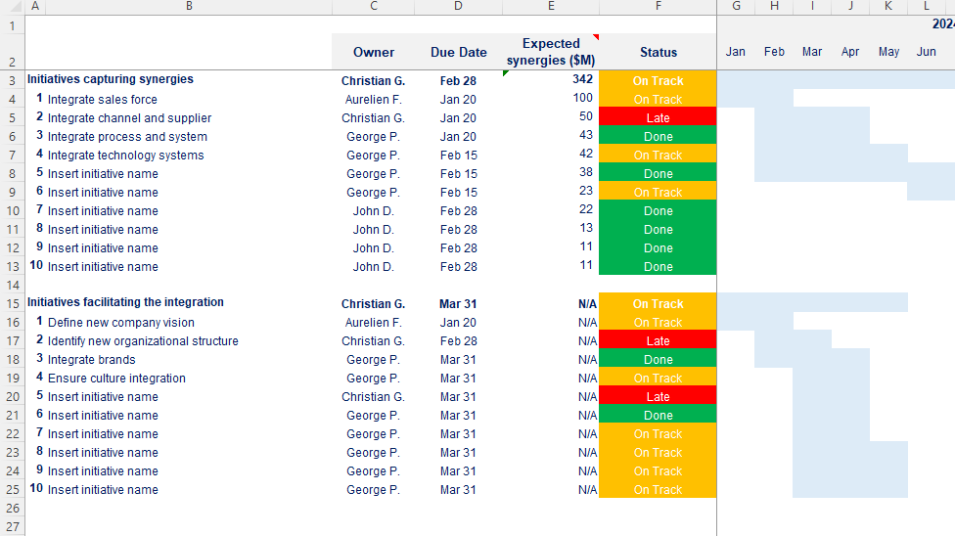
Phase 6 small preview
1
2
3
4
5
6
Define your M&A Strategy
Identify Target Companies
Build a Business Case and Financial Model
Conduct a Due Diligence
Execute Transaction
Conduct the Post Merger Integration
7
Activities specific to Carve-outs:
1.Exit readiness
2.Transaction perimeter
3.Separation concepts
4.Management presentation
5.Legal entity
6.Separation execution

Slide 15
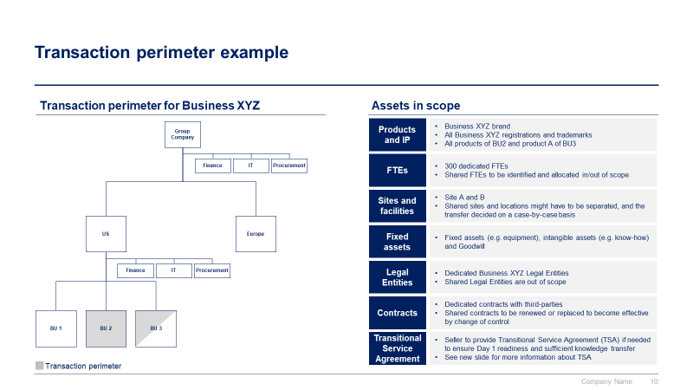
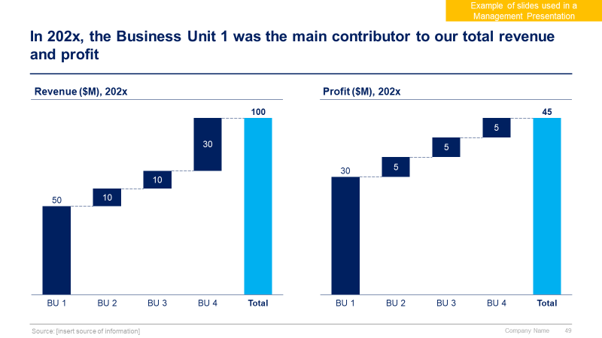
Phase 7 small preview
1
2
3
4
5
6
Define your M&A Strategy
Identify Target Companies
Build a Business Case and Financial Model
Conduct a Due Diligence
Execute Transaction
Conduct the Post Merger Integration
7
Activities specific to Carve-outs:
1.Exit readiness
2.Transaction perimeter
3.Separation concepts
4.Management presentation
5.Legal entity
6.Separation execution

Slide 16
Examples of companies that have executed successful mergers and acquisitions (M&A) strategies
Disney’s Acquisition of Pixar
Facebook’s Acquisition of Instagram
Salesforce and Slack Acquisition
Year: 2006
Deal Value: Approximately $7.4 billion.
Context: The Walt Disney Company acquired Pixar Animation Studios, a pioneer in computer-generated animation.
Outcome: This strategic move allowed Disney to strengthen its animation capabilities significantly. Pixar’s creative talent and successful film franchises (such as “Toy Story,” “Finding Nemo,” and “The Incredibles”) became integral to Disney’s continued success in the animation industry.
Year: 2012
Deal Value: Approximately $1 billion.
Context: Facebook acquired Instagram, a popular photo-sharing app with a rapidly growing user base.
Outcome: The acquisition allowed Facebook to expand its social media ecosystem and tap into Instagram’s younger user demographic. Instagram continued to thrive independently while benefiting from Facebook’s resources and expertise.
Year: 2021
Deal Value: Approximately $27.7 billion.
Context: Salesforce, a cloud-based software company, acquired Slack, a popular collaboration platform.
Outcome: The acquisition strengthened Salesforce’s position in the enterprise software market and expanded its offerings to include team communication and collaboration tools.

Slide 17

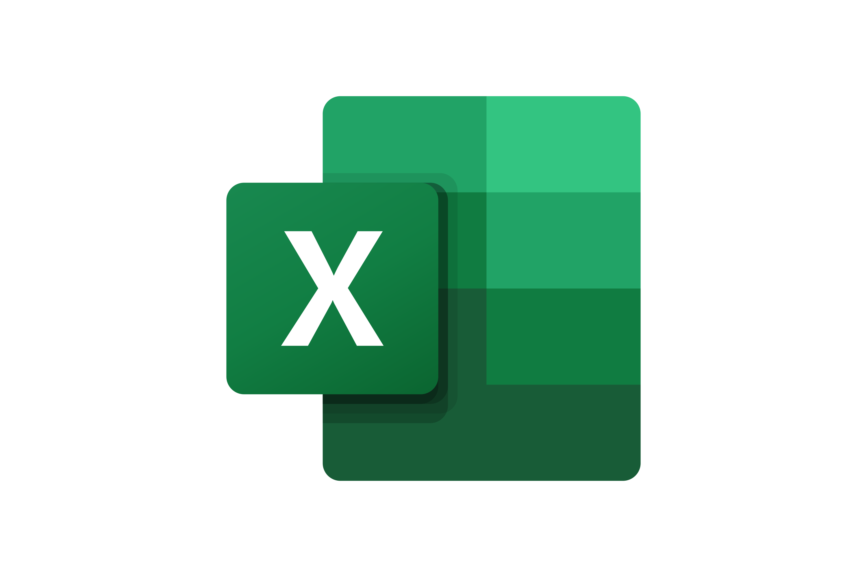

The Toolkit includes multiple PowerPoint slides, Excel sheets and Video training that you can download on your device immediately after purchase
900 editable PowerPoint slides*
65 Excel sheets*
70 minutes of Video training
0. Overview and Approach
I. M&A Strategy
II. Target companies
III. Business Case and Financial Model
IV. Due Diligence
V. Transaction Execution
VI. Post Merger Integration
VII. Carve-outs
*Please note that the number of PowerPoint slides and Excel sheets listed is the number of unique slides and sheets. For example, a PowerPoint slide that has been duplicated to facilitate our clients’ understanding only counts for one slide

Slide 18









Our Management Consulting Toolkits include 9 key benefits
Improve the growth & efficiency of your organization by leveraging Management Consulting Toolkits created by ex-McKinsey, Deloitte & BCG Consultants.
Make a great investment for your career & organization. It cost us US$8M+ over the past 10 years to create all our Toolkits. Get them for a fraction of this cost.
Get a competitive advantage. It’s like hiring Management Consultants to create all the practical Frameworks, Tools & Templates you need.
Get the job done quicker and never start from scratch again with our ready-made and fully editable Frameworks, Tools & Templates in Powerpoint & Excel.
Don't reinvent the wheel. We have already worked 30,000+ hours over the past 10 years to create all the Management Consulting Toolkits you need.
Improve the capabilities of your organization by learning how the Fortune 100 and Global Consulting Firms do it.
Decrease your costs. Hiring tier-1 Consultants for a project would cost you $300k+. Way more expensive than our Toolkits, which will last you a lifetime!
Become your organization’s subject matter expert and impress your stakeholders with world-class approaches to resolve common business problems.
Get free support and advice from our ex-McKinsey, Deloitte & BCG Management Consultants.

Slide 19
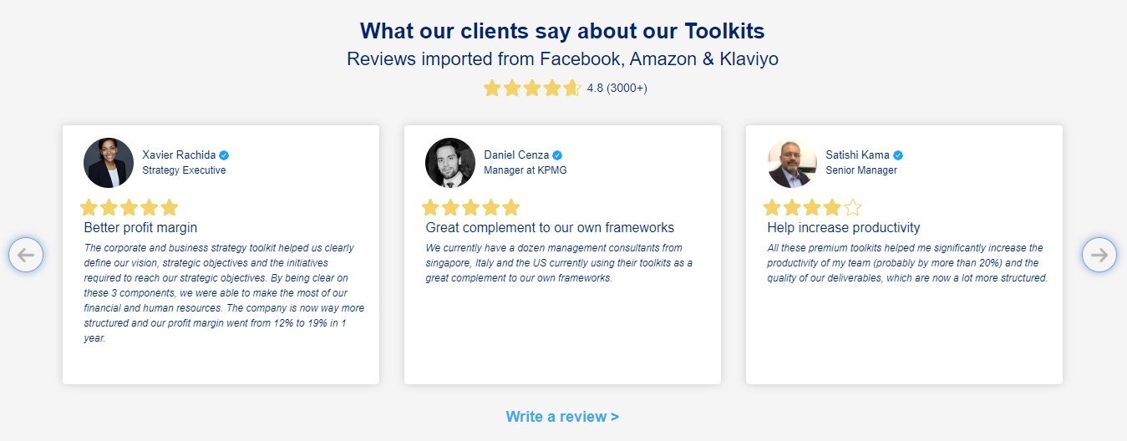
What our clients say about our Toolkits
Click here to see more reviews >

Slide 20

Join 200,000+ Executives, Consultants & Entrepreneurs leveraging our Toolkits to improve the performance of their organization
Trusted by small and large organizations
Customer satisfaction
4.8
Number of countries leveraging our Toolkits
160+
Number of professionals leveraging our Toolkits
200,000+
Daily rate of our ex-McKinsey, Deloitte and BCG Management Consultants
$3k-$4k

Slide 21

Interested in more than 1 Toolkit? Access all our Toolkits for half the price with our Gold Access
Gold Access
Click here to learn more

Slide 22
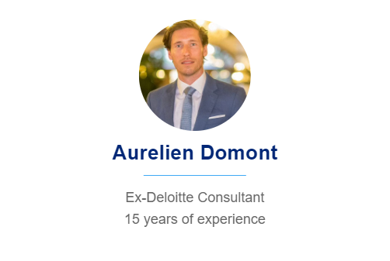

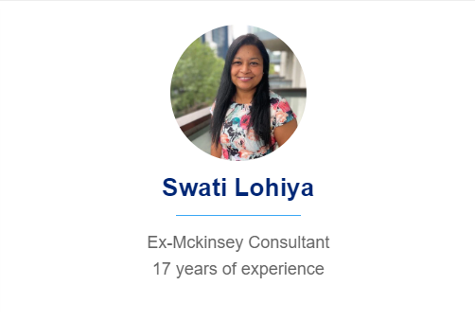
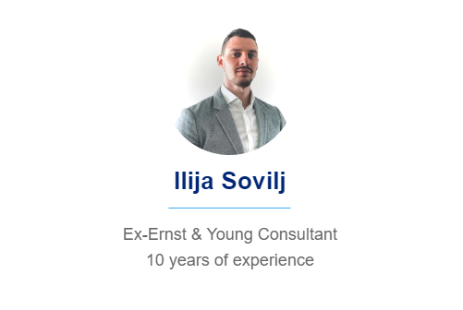
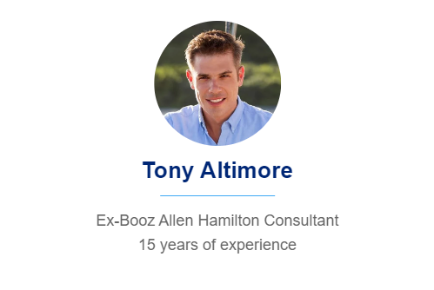
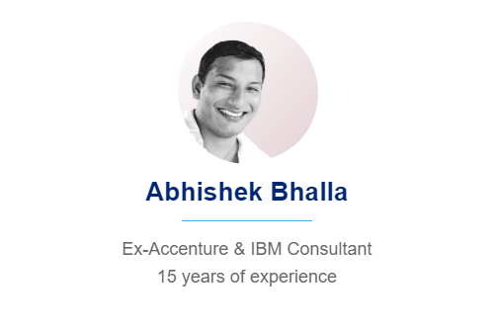
Need additional help? Send us a brief and we’ll find you the right talent from our network of 500+ tier-1 Management Consultants
Click here to send us a Project Brief

Slide 23

This was just a small preview.
www.domontconsulting.com

